Slide 1




STGI
DOCUMENT GENERATION
BitByBit

Slide 2

SARTHAK GARG
TEAM LEADER
TEAM MEMBERS
SAKSHAM BENIWAL
GARV BANSAL
TECH PERSONNEL
NON-TECH PERSONNEL
SHUBH JAISWAL
VISHNU BANSAL
TECH PERSONNEL
TECH PERSONNEL
github.com/Sar-thak-3/BitByBit/

Slide 3
PROBLEM STATEMENT
FOCUS AREA
Converting HTML (Hypertext Markup Language) documents to DOCX (Microsoft Word) format. While both formats serve different purposes, there are scenarios where it's necessary to convert HTML content into a more widely used and editable format like DOCX.
Preseving Formatting and Styles
Dealing with Hyperlinks and References
Supporting Complex HTML Structures
Minimizing Data Loss
Scalability and Performance

Slide 4
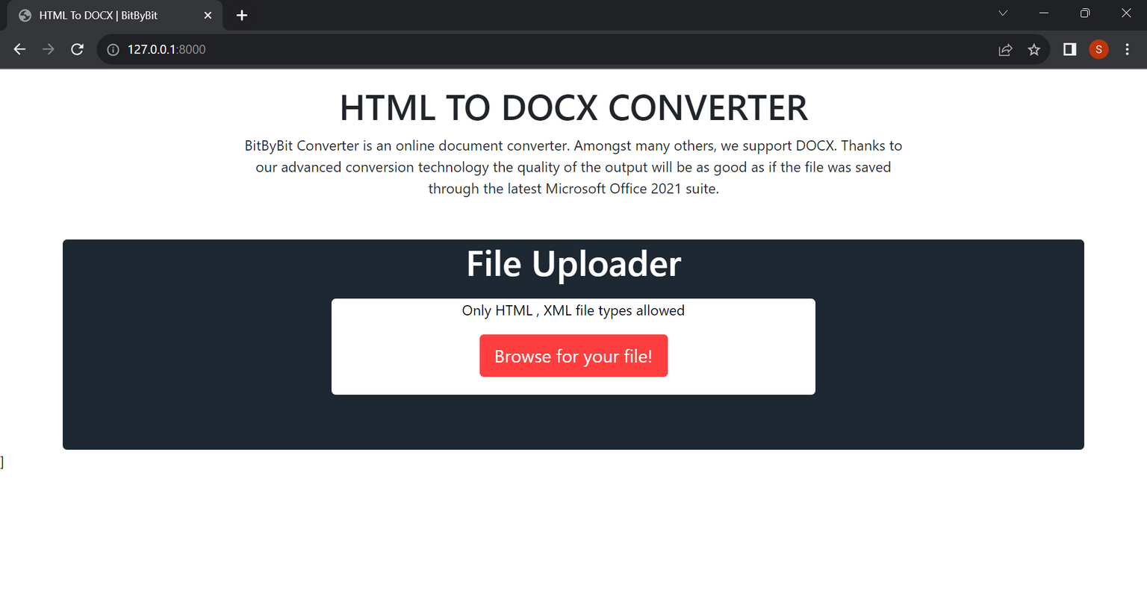
FRONT END
We have created a user-friendly form using HTML, CSS, Bootstrap, and JavaScript.
The form allows users to upload a file, which is then processed.

Slide 5
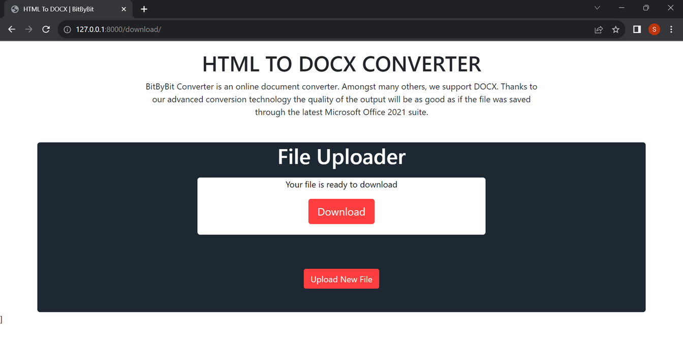
FRONT END
Once the processing is complete, a downloadable DOCX file is generated.
The combination of these technologies ensures a seamless and responsive user experience.

Slide 6
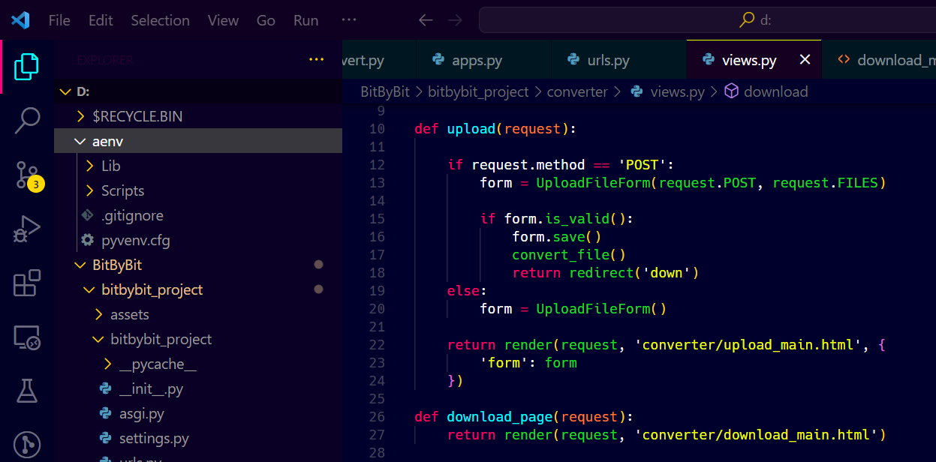
BACK END
In the backend of this project, we have implemented a robust system to handle file uploads and processing.
Upon receiving a file from the user, it is stored in a designated model.
Subsequently, the file undergoes processing and is converted into a DOCX format.

Slide 7
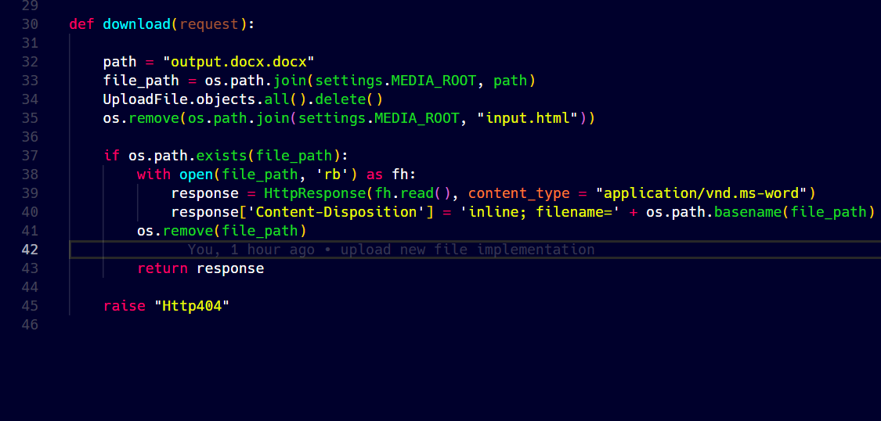
BACK END
Finally, the processed document is promptly sent back to the user via an HTTP response.
This backend workflow ensures efficient handling and delivery of processed files, enhancing the overall user experience.

Slide 8
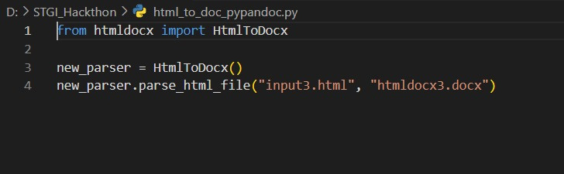

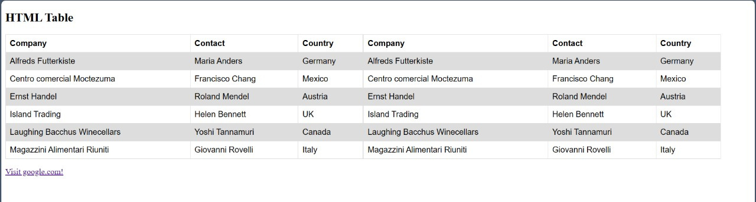
HTML TO DOCX
Utilized the following python libraries for the docx conversion.
Given HTML template

Slide 9
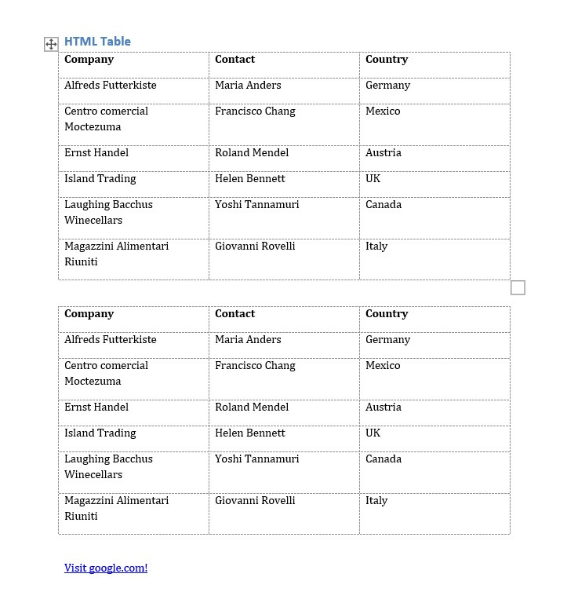
This conversion to docx is not very accurate and has various problems :-
The watermark is not visible.
The color of a tab in a table cannot be obtained.
Color of paragraph is not achievable as that in the Html document.
These problems are not being solved by the given open source libraries.
12 Months Plan
Generated .docx using the previous code with the help of libraries.

Slide 10
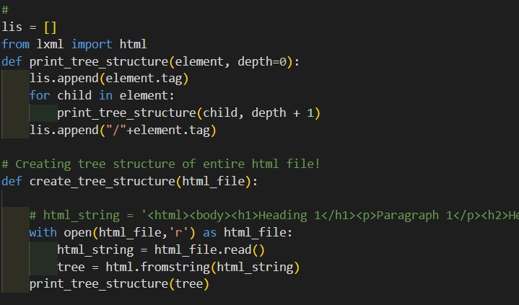
Solving the previous problems:
Docx file generated is now altered using various steps:
-> The original HTML file is made inlined styled.
-> Created the Tree structure of entire Html files to extract all the Html tags.
-> Utilized BeautifulSoup to parse every HTML tag
-> These html tags are now mapped with the Tree structure and the styling is extracted.
-> Using self created functions with the help of python libraries, manipulated the whole styling in the docx.
Function to create Tree structure

Slide 11
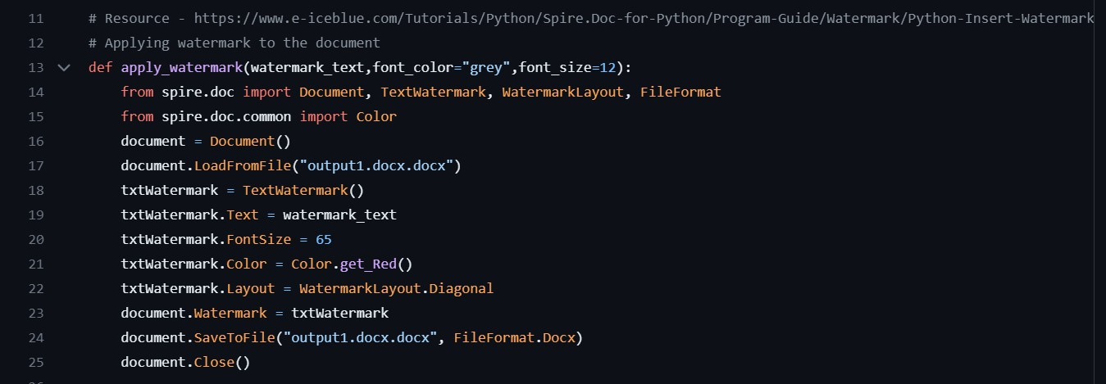
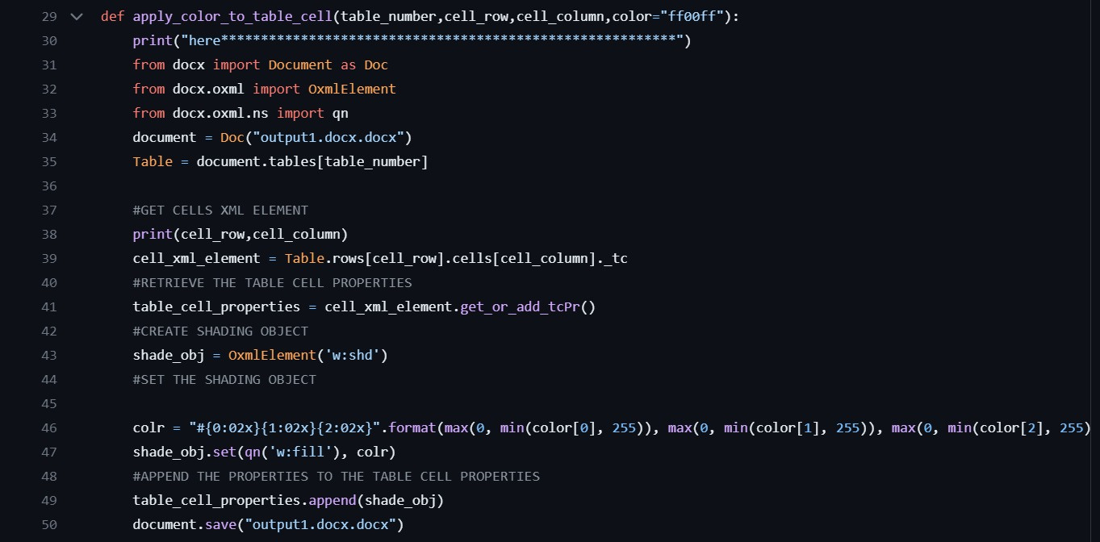
Function to apply watermark
Function to apply color to table

Slide 12
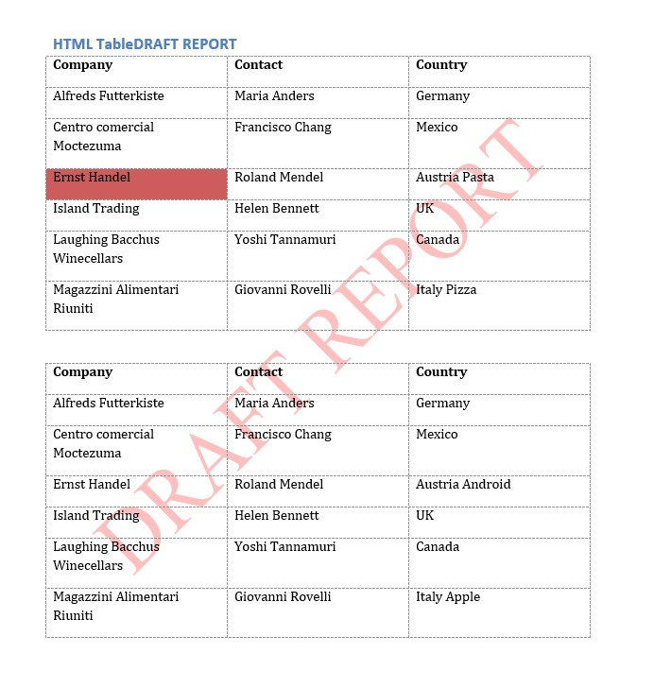
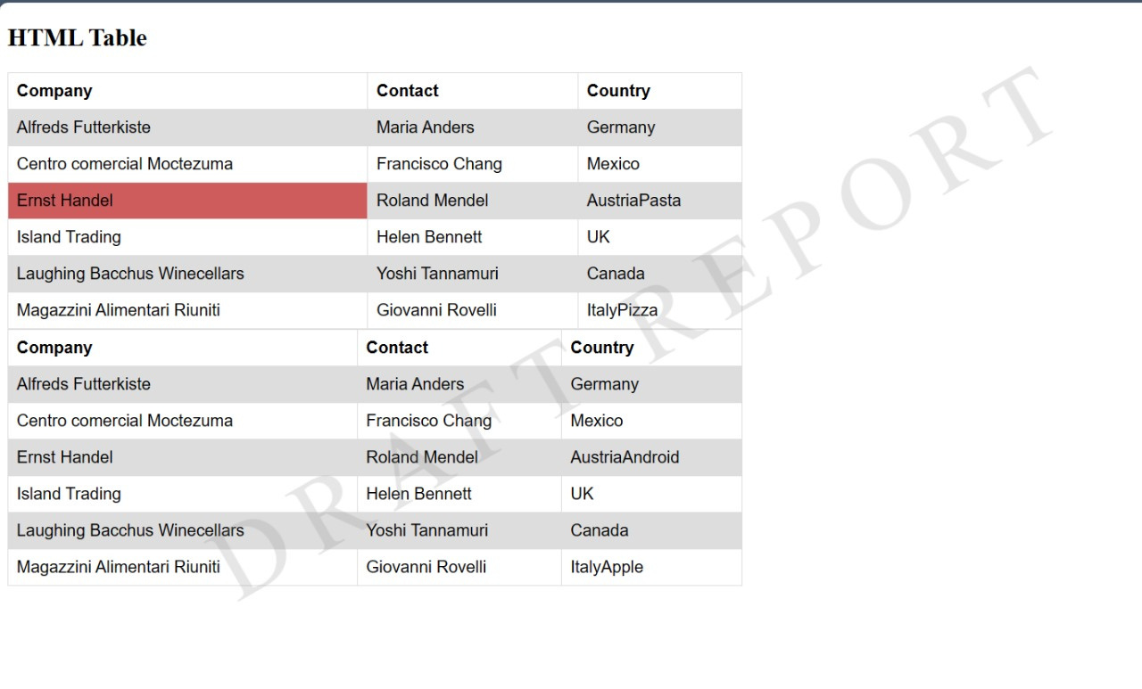
ORIGINAL
CONVERTEDO

Slide 13
THANK YOU!
Team - BitByBit

